Slide 1
UAV Project
機械所 洪得瑜 309611087

Slide 2
UAV Final project
In this project, each team has to complete the following part:
(10%) Select 10 points and visualize them on Rviz.
(40%) Implement QP trajectory planning using points you selected in part 1, and visualize trajectories on Rviz.
(10%) Run UAV‘s gazebo simulation and make it fly in trajectories you planned with the following topic: “/${arg mav_name}/command/trajectory". Notice that the heading of it should be towards its velocity direction.
(40%) Construct a UAV formation team with one leader and two followers, the heading direction of them should be the same, and followers should remain behind the direction the leader is facing. (Coordinate transformation is needed)
Final Project 目標
在Rviz中設置10點位置由QP軌跡規劃產生最優路徑,將路徑點發布在節點上,由主無人機接收路徑規劃軌跡飛行,在增加2部追隨無人機,且追隨無人機依照主無人機狀態飛行,及固定相對位置在主無人機位置。

Slide 3
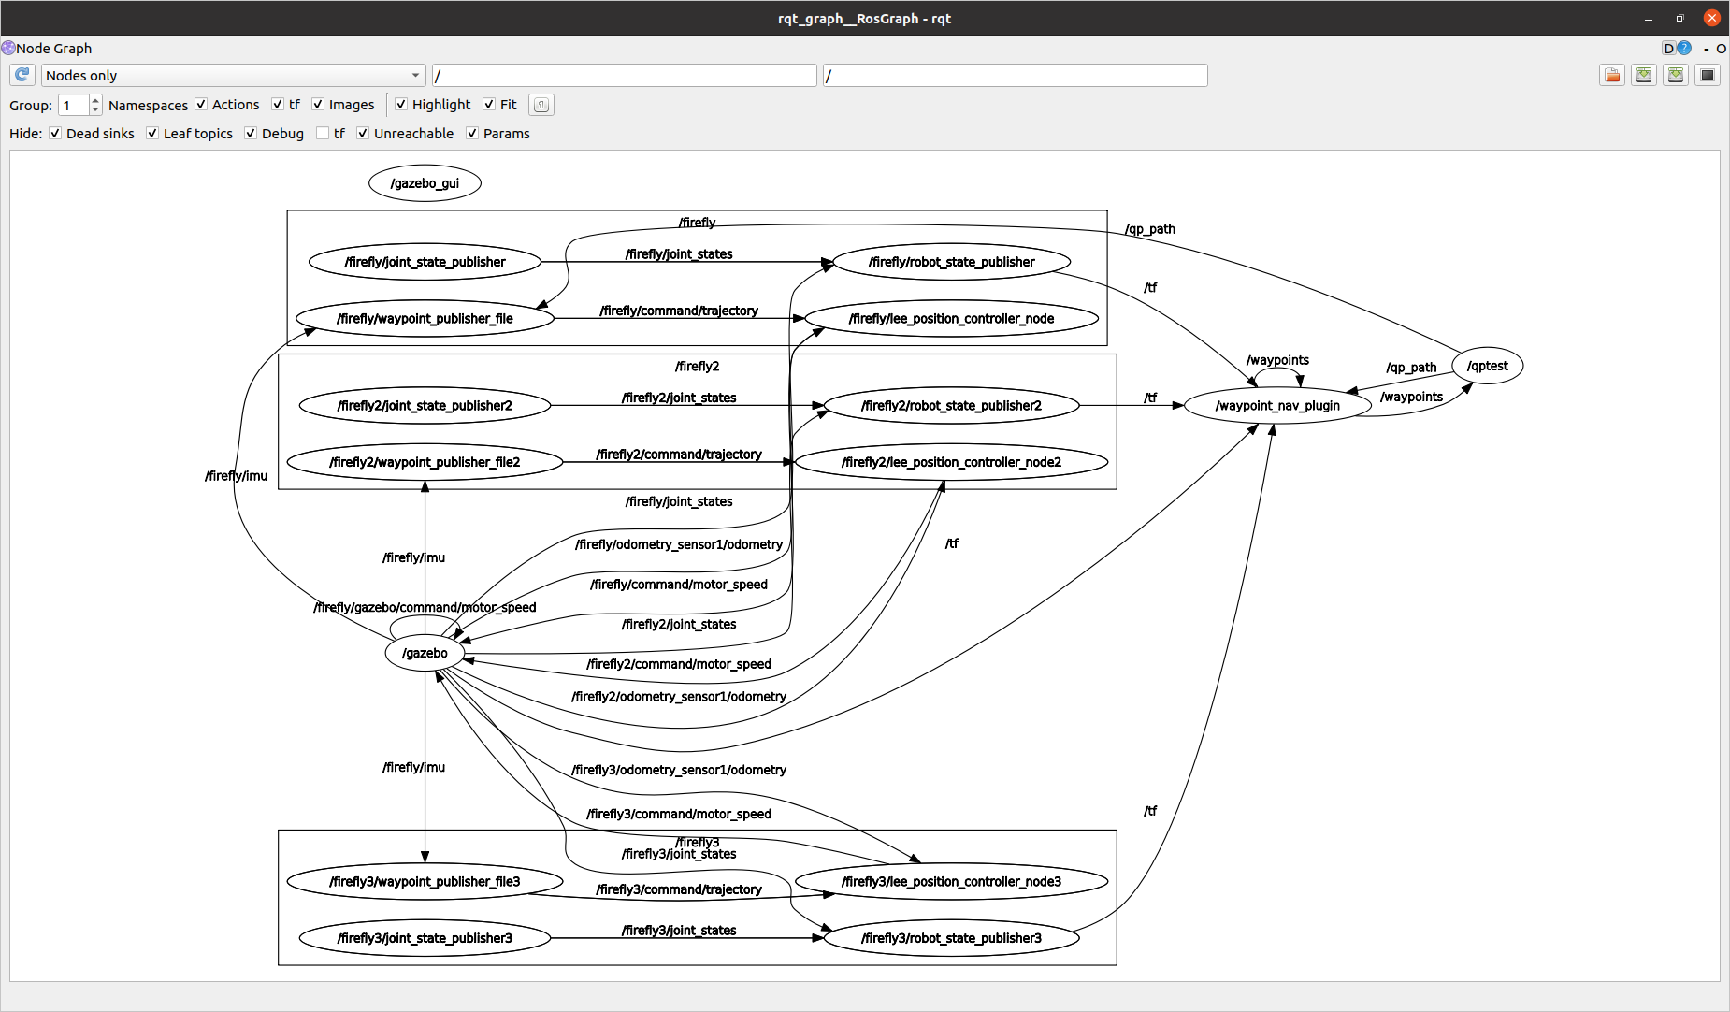
rqt_graph
QP 最佳化軌跡
主無人機
Follow 無人機1
根據主無人機
IMU 及 odom 狀態追隨
Follow 無人機2

Slide 4
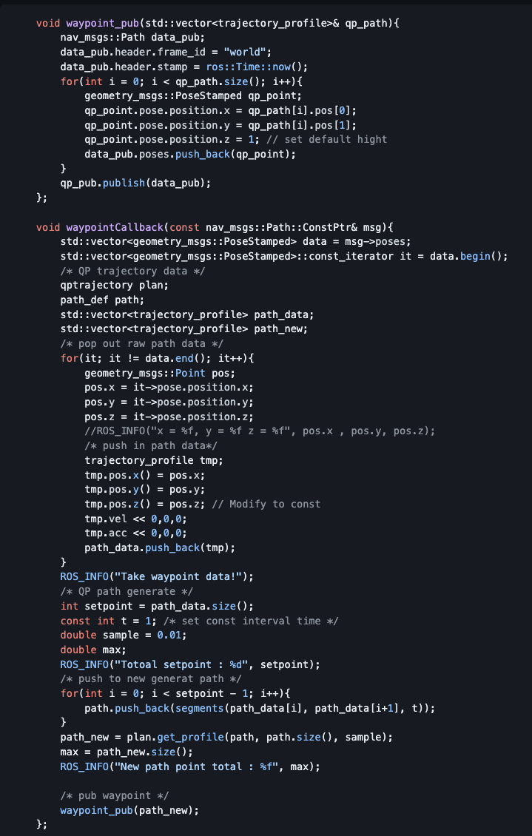
Rviz wapoints to QP path
修改發佈/waypoints到指定坐標系world.
任意點選10點點座標後由Publish Waypoints 到/waypoints節點上
而/waypoints有發布點座標在由qptrajectory節點接收座標位置
透過qptrajectory節點計算QP路徑結果,並將規劃結果發布到/qp_path節點上

Slide 5
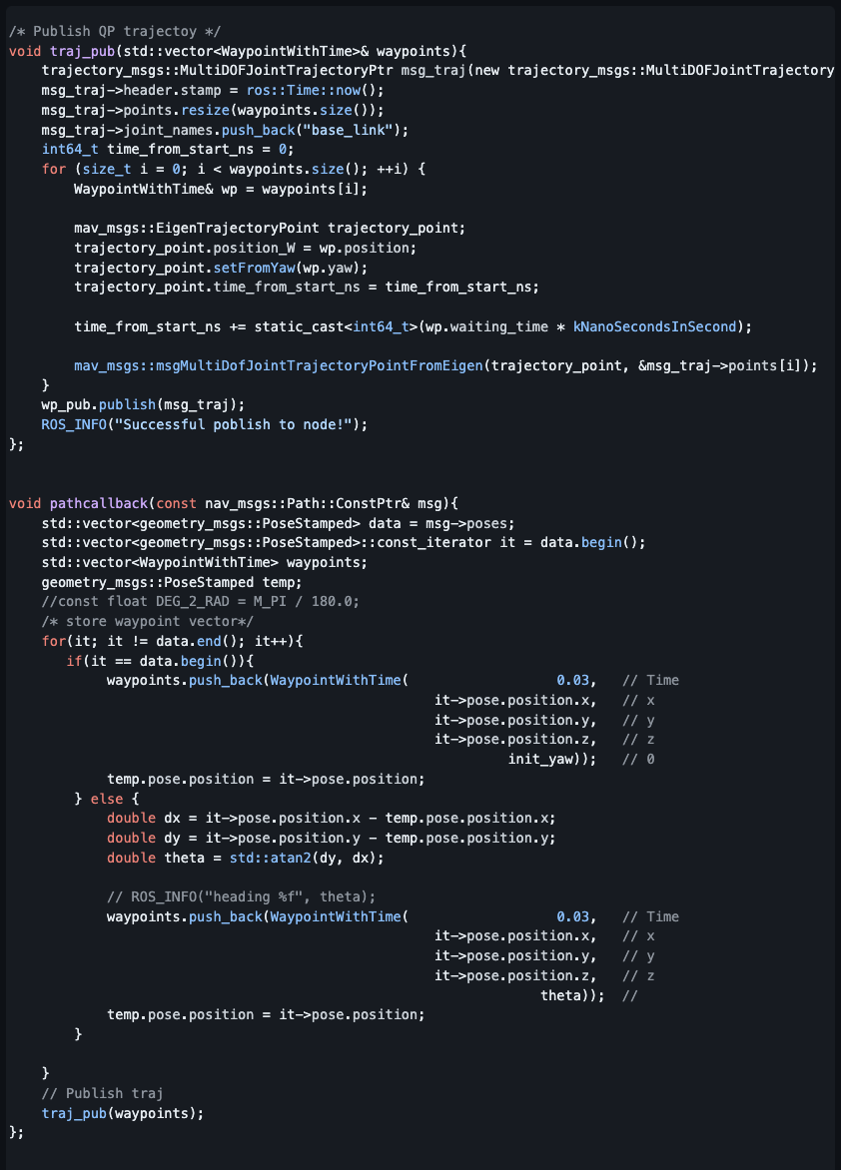
QP trajectory move and spawn UAV
由主無人機節點接收/qp_path路徑,並重新計算desire yaw
重新將/qp_path資料型態改為trajectory_msgs::MultiDOFJointTrajectory重新發布
而發布的路徑為命令與UAV已作Topic連結,即發布到指定UAV節點控制無人機.

Slide 6
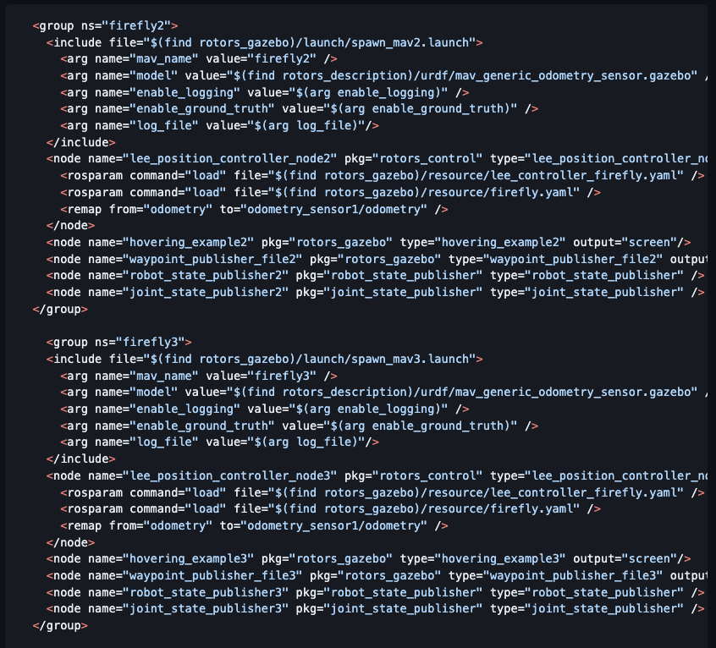
Follower UAV
Spawn UAV 在 mav_with_waypoint_publisher.launch file中增加無人機模型

Slide 7
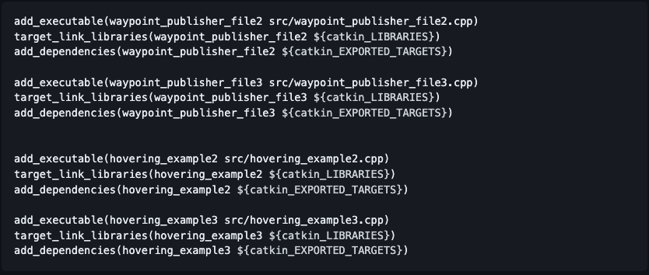
Follower UAV
並修改 CMakeLists.txt 增加編譯路徑

Slide 8
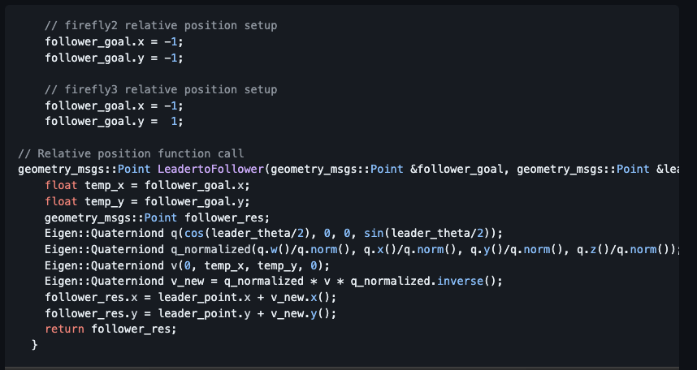
Follower UAV
3.在waypoint_publisher_file2.cpp 及 wapoint_publisher_file3.cpp 訂閱主無人機位置及姿態資訊/firefly/imu 及 /firefly/odometry_sensor1/position 計算出相對固定位置及姿態飛行

Slide 9
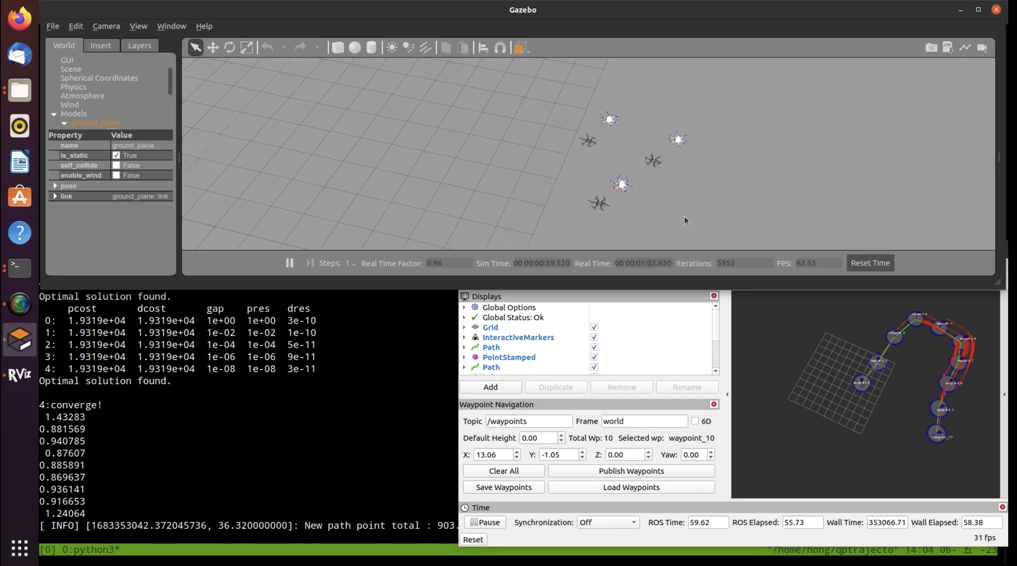
Result of Video
Link : https://www.youtube.com/watch?v=Ktfvc9yTbzQ
Github : https://github.com/DavidHong1997/UAV_Final.git

